Slide 1

PROJECT PRESENTATION INTELLIGENT TEXT TAGGER
By Nandakishore Ellendula

Slide 2

Project Scenario
In modern organizations, large volumes of text are generated daily—meeting notes, design documents, reports, and support tickets.
Manually tagging and organizing these documents is time-consuming and inconsistent.
The Intelligent Text Tagger automates this process by extracting meaningful tags, improving document search and knowledge management.

Slide 3

Goal of the Project
We aim to build a Python-based AI system that can:
Read a set of text documents (.txt or .md).
Automatically suggest relevant keywords.
Together, the project's vision and mission form the foundation
Collect user feedback (approve/reject).
Learn from feedback to improve future suggestions.
This creates an adaptive and self-improving system.

Slide 4

System Workflow Overview
Step 1: Ingest documents from a folder.
Step 2: Extract candidate keywords using NLP (tokenization, POS tagging, noun phrase extraction).
Step 3: Rank candidates using TF-IDF.
Step 4: Suggest top-K tags.
Step 5: Collect feedback (approve/reject).
Step 6: Adjust tag scores based on feedback.

Slide 5

How Feedback Improves the System
1
2
3
Approved tags have their scores boosted.
Rejected tags have their scores reduced.
Adjustments are stored in feedback.json.

Slide 6
Example Scenario in Action
Input Documents:
- sample1.txt (Meeting notes)
- sample2.md (Support logs)
Initial Tags:
'design review', 'agenda', 'attendees'
'login failure', 'password reset', 'user reports'
Feedback:
Approve: 'design review'
Reject: 'attendees'
Next Run:
- 'design review' boosted.
- 'attendees' reduced.

Slide 7
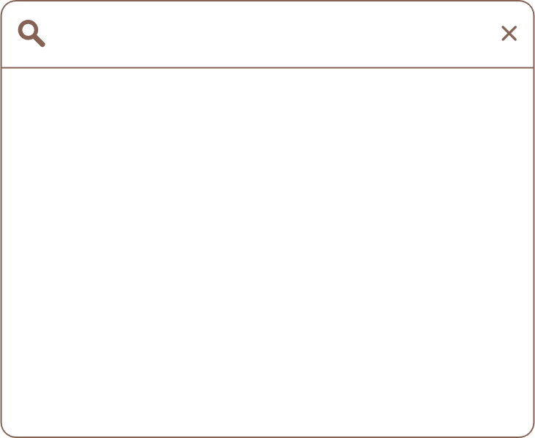
Technologies used
Python Standard Libraries (file handling, JSON, CLI
NLTK – tokenization, POS tagging, noun phrase extraction
Flask – web interface
PyTest – for testing and validation
Scikit-learn, TF-IDF Vectorization and scoring

Slide 8
Results and Impact
Reduces manual tagging effort
Improves document searchability
Learns and adapts to user feedback
Extensible to LLMs and vector search for semantic tagging

Slide 9

Future Enhancements
Integrate Large Language Models (LLMs) for semantic understanding.
Use vector databases for contextual tagging.
Create a visual dashboard for tag analytics.
Add support for more document formats like PDF and DOCX.

Slide 10
Conclusion
The Intelligent Text Tagger is an adaptive AI-powered system combining NLP and user feedback.
It reduces manual effort, enhances knowledge organization, and can evolve into a semantic tagging solution for enterprise use.

Slide 11
ANY QUESTIONS?

Slide 12

THANK YOU.

